Slide 1
The Case for Global public investment (GPI)
Jonathan Glennie (JLI)
Simon Reid-Henry (QMUL)
Anton Ofield-Kerr (Equal International)

Slide 2
Basic Overview
How does GPI differ from ODA?
ALL countries contribute (according to ability)
ALL countries receive (according to need)
TRANS-national (global, regional, local) public goods and services are better funded
What else could it do?
Provide much-needed funding up-front and long-term for under-resourced global public goods (pump-priming and sustainability inducing) .
Bring MICs as key players back into the global funding picture
Could have immediate applications for Covid-19.
A new and ongoing means of financing sustainable development for all countries in the 21st century.

Slide 3
Context
High ambitions and growing threats
ODA long term trends (graduation, MICs) plus pledging rounds falling short (e.g. ACT-Accelerator funding for global C19 response: how raise US$31bn; or US$2.4bn within COVAX by end Aug?)
Rising role of Southern economies
Rich world public spending squeeze.
Covid19 changes political possibilities
GPI is not “the” answer, but an important part of the answer of how to fund sustainable development.
The aid landscape is changing; new public financing needs increasingly confront all countries: we lack a mechanism for funding this need, as Covid-19 underscores.
Notes:
On long term trends: all countries have needs that touch upon the GPI proposal.
Poor countries need continued investments that ODA cannot meet. MICs still have developmental needs, and “poor” citizen, even after official “graduation”.
Rich countries too have unmet needs. We are familiar with the rich world debt crisis since 2008/9. But share of government spending allocated to public investments (infrastructure in all sectors, say) has more generally been decreasing in recent decades, losing out to public consumption (recurrent costs) and transfers. Ageing populations will intensify this, leaving countries, also domestically, needing to find new ways of investing in basic things that societies need. Cross-national cooperation on GPG-type requirements could be an important (and efficient) part of that and will also, as Covid shows, be a growing area of need in itself.
GPI can help meet future domestic need in countries at all income levels. We really ARE all developing nations still, and we need a funding mechanism that responds to this fact.
On funding gaps. EIU data suggests pledges for Covid-19 response drying up. 4 May 2020: $8.85bn pledged; 27 June 2020: $9.83bn pledged. This is Tedros’s “Vast Global Gap”

Slide 4
principles
If all countries channeled 0.7% of their GNI to Global Public Investment, we could raise c. $375 bn in new funding for sustainable development
Notes:
If $375 bn sounds a lot to raise, recall that the global economy is currently losing this exact amount every month during the pandemic (IMF):
https://blogs.imf.org/2020/04/14/the-great-lockdown-worst-economic- downturn-since-the-great-depression/

Slide 5
MEchanisms
All countries commit to spending a fixed proportion of GNI annually on GPI compliant spending.
At its simplest this would see rich countries contribute proportionally more to the funding of global public goods and services from which all countries benefit equally (e.g. cleaner air).
A portion of this money could be transferred through to regions, nations and localities (as per EU Cohesion Funds, for example); another portion might be retained for directly financing globally-agreed priorities (e.g. pandemic response capacity).
Via block grants, formula grants, subsidies; payments into existing facilities, etc.
All countries would have a proportional share of decision-making power in the governance structure, alongside civil society and other stakeholders (as per the Global Fund, for example)
GPI represents a new era of transparent and representative global governance for public finance
Notes:
An example: At the heart of a more multilateral and multidirectional series of transfers and co-financing arrangements, a core fund (International Investments Fund – IIF) could provide capital base for raising further private finance. This would only be a part of the GPI structure. It would be overseen by a transparent and representative global oversight organ (International Investments Fund Cooperation Committee – IIF-OC) a little as OECD-DAC works, less representatively, at present for ODA.
Note: Individual countries could also set up their own funds within this with their contributions counted towards the total (e.g. Norway with its 10 long term development partner countries).

Slide 6
Our objectives
At this point these are all just ideas. BUT. We would like to see:
Development and gradual adoption by key stakeholders (govts and others) of the GPI principles: Ideas Shift
Practical application at fund/programme level across the world: Practical Shift (within Existing Programmes)
Redefining how international spending on sustainable development works (for all nations) as the new, post-2030 paradigm replacing ODA: Paradigm Shift
Stepwise progress, via advocacy and concept refinement, towards concrete applications, with Covid-19 response an immediate application.

Slide 7
WHAT NEXT
Launching an Expert Working Group (September 2020)
Two panels: technical and political
Address Qs such as optimal % contribution; institutional mechanisms, governance structures, evidence base and performance criteria.
Securing Stakeholder Engagement (2020-21)
We see a key role for numerous international actors to engage in advocacy to support this work.
We also see potential in pursuing GPI within the context of current Covid-19 funding needs (e.g. the ACT Accelerator).
Gaining Institutional Buy-in (2021-)
Working with partners and key stakeholders, the mid-longer term plan will be to roll out GPI as a new international public finance mechanism.
A timeline for change

Slide 8
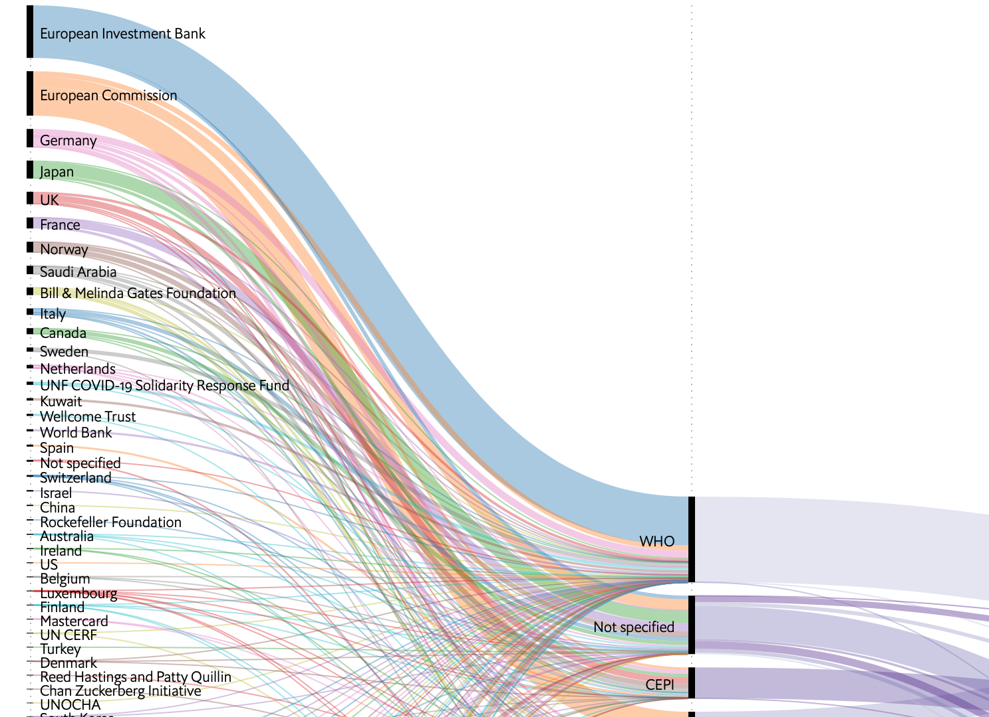
Pledges to date for Covid-19 Response (Source: EIU).
The short story?
We need to do more.

